Slide 1
Endava Social Analyzer
Presented by Damir Alibegovic

Slide 2
Agenda
Introduction of the team and product
Live demo
Technology stack
Benefits of using our product
Future plans
Q&A

Slide 3
Introduction
Tarapana team members:
Slavko Komarica
Marko Kaplarevic
Milos Mutavdzic
Dejan Kojic
Damir Alibegovic

Slide 4
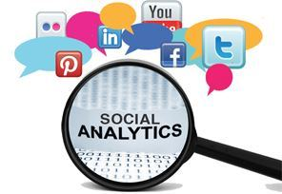
Introduction
What is social analytics?
Collection and analysis of statistical, digital data on how users interface with an organization
Primary form of business intelligence, used to identify, predict, and respond to consumer behaviour

Slide 5
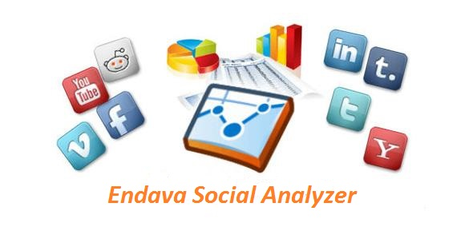
About product
What is Endava Social Analytics?
Do your have your overall marketing and business strategy centralized?
Have you defined marketing and business goals that can be tied to actions and events on just one place?
How can you prove the value and impact of your social media activity?
Do you have Endava Social Analytics?

Slide 6
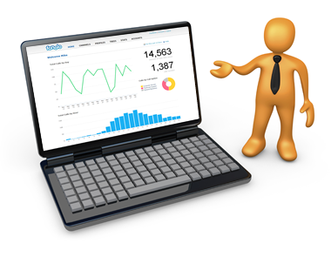
Live Demo

Slide 7
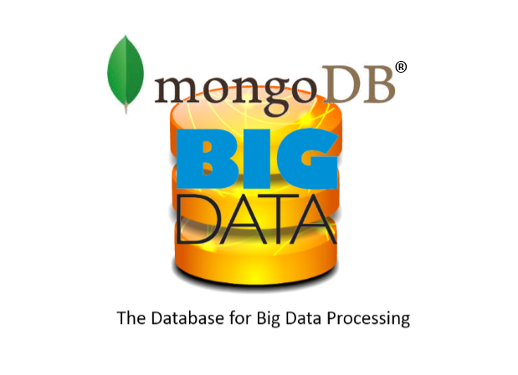
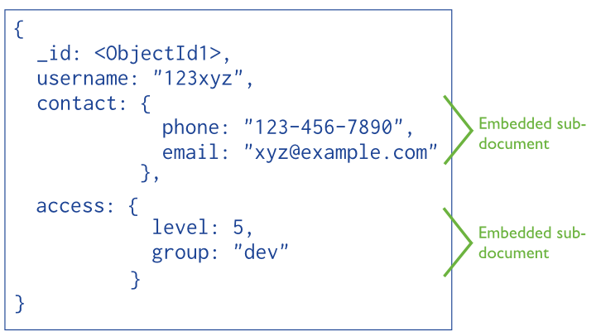
Technology stack
MongoDB
High insert rate over transaction safety
Database scaling
Data is location based
Load and performance advantage

Slide 8









Technology stack

Slide 9
Benefits
The reasons behind developing the solution
Who will benefit from it (target market)
Financial benefits
Performance/productivity improvements
Other benefits (ex. Life improvement)

Slide 10

Future releases
Adding support for Tweeter and LinkedIn
Extended scope of data from social networks based on research
Different types of analytical reports
Configurable analytical reports
Adding post functionality

Slide 11
Thank you for your attention!

